Slide 1
Lecture 14 Minimum Spanning Trees
Department of Computer Science
Hofstra University
1

Slide 2
Lecture Goals
In this lecture we study the minimum spanning tree problem.
We consider two classic algorithm for the problem—Kruskal's algorithm and Prim's algorithm.
Both are greedy algorithms that are also optimal.
2

Slide 3
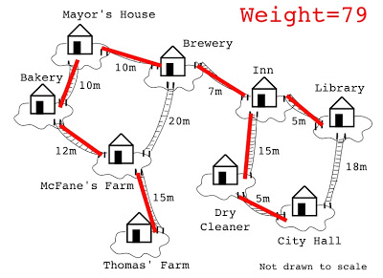
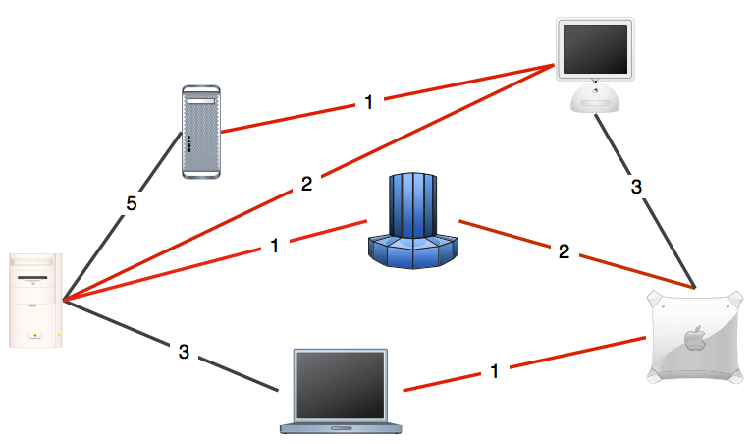
Minimum Spanning Tree Problem
A telecommunications company tries to lay cable in a new neighborhood. If it is constrained to bury the cable only along certain paths (e.g. roads), then there would be a graph containing the points (e.g. houses) connected by those paths.
Some of the paths might be more expensive, because they are longer, or require the cable to be buried deeper; these paths would be represented by edges with larger weights.
A Minimum Spanning Tree (MST) is the one with the lowest total cost for laying the cable.
Other applications: Network design, Cluster analysis….
3

Slide 4

Power Plant Example
It’s the 1920’s. The electric company needs to choose where to build wires to connect all these cities (A,B, C, D, E) to the power plant
They know the cost of to lay electric wires between any pair of cities, and wants the minimize the total cost of these wires
B
6
3
E
2
1
C
A
10
9
5
7
4
D
8

Slide 5
Shortest Path vs Minimum Spanning Tree
Shortest Path Problem
Minimum Spanning Tree Problem
Given: a directed or undirected graph G and vertices s, t
Find: the shortest path from s to t.
Given: an undirected graph G
Find: A set of edges with minimum total sum of weights such that you can get from any vertex of G to any other on only those edges.
B
SPT from power plant
B
MST of the graph
6
6
3
3
2
E
2
E
1
C
1
C
A
10
9
A
5
4
7
Power plant
4
Power plant
D
D
8
Minimum Spanning Tree
Goal: minimize total sum of edge weights. Only one possible MST (if no equal edge weights)
Keeps track of cheapest edges that maintain connectivity
Shortest Path Tree
Goal: minimize distance from a specific start node (if you have a different start node, that changes the whole SPT)
Keeps track of total path length
Notes:
, so there are multiple SPTs All nodes connected

Slide 6
Minimum Spanning Tree (MST)
Given. Undirected graph G with positive edge weights (connected).
Def. A spanning tree of G is a subgraph T that is both a tree (connected and acyclic) and spanning (includes all of the vertices).
Goal. Find a minimum weight spanning tree.
4
24
4
24
23
9
23
9
6
18
6
18
5
11
5
11
16
8
16
8
10
14
7
10
14
7
21
Brute force.
Try all spanning trees?
21
graph G
not connected
4
24
4
24
23
9
23
9
6
18
6
18
5
11
5
11
16
8
16
8
10
14
7
10
14
7
21
21
not acyclic
Minimum Spanning Tree T: cost = 50 = 4 + 6 + 8 + 5 + 11 + 9 + 7

Slide 7
Greedy Algorithms
A greedy algorithm makes the locally optimal choice at each step
We learned Dijkstra’s algorithm for the shortest path problem
We will learn Kruskal and Prim’s algorithms for the minimum spanning tree problem
In the lecture and exams, when there are multiple possible orders of visiting the next node (in case of a tie), we generally select the next node in alphabetical or numerical order
The solution will always be guaranteed to be optimal, but the MST may be different depending on the order of visits

Slide 8
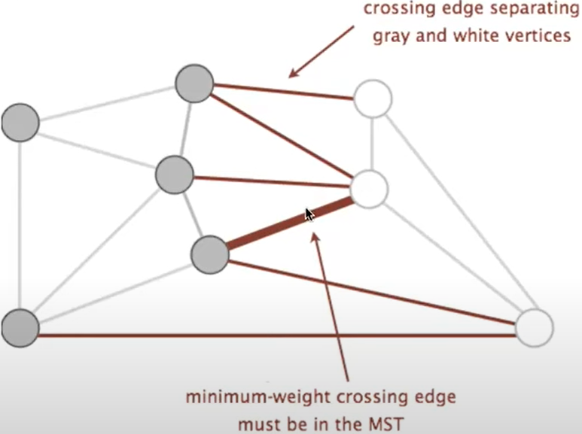
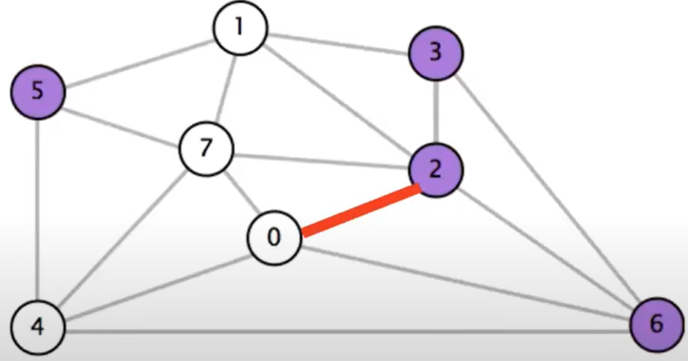
A Useful Tool for Finding the MST: Cut Property
A cut is an assignment of a graph's nodes to two non-empty sets.
A crossing edge is an edge which connects a node from one set to a node from the other set.
Cut property: Given any cut, minimum weight crossing edge is in the MST.
In case of a tie, pick any edge with equal weight. Different choices will results in different MSTs.
Notes:
https://github.com/poanc/NoteBook/issues/118
crossing edge separating gray and white vertices
minimum-weight crossing edge must be in the MST

Slide 9
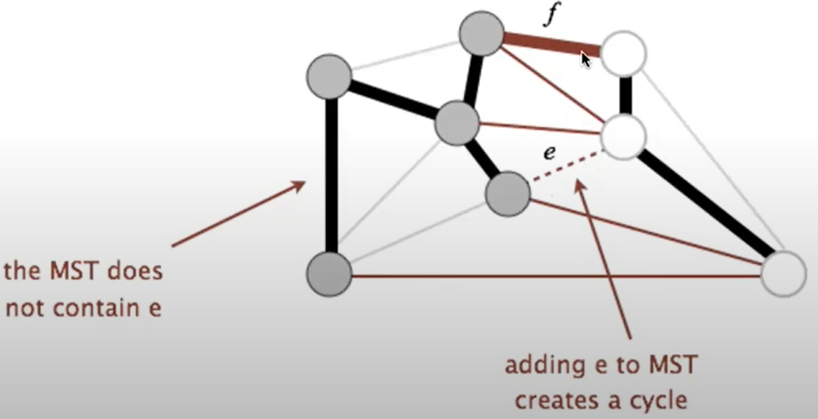
Proof of the Cut Property
Suppose that the minimum crossing edge e were not in the MST.
• Adding e to the MST creates a cycle.
• Some other edge f must also be a crossing edge.
Replacing f with e results in a lower weight spanning tree. Contradiction!

Slide 10
Generic MST Finding Algorithm
Start with no edges in the MST.
Find a cut that has no crossing edges in the MST.
Add smallest crossing edge to the MST.
Repeat until V-1 edges are added.
This should work, but we need an efficient way of finding a cut with no crossing edges
Prim’s Algorithm
Kruskal’s Algorithm
Notes:
Random isn't a very good idea.

Slide 11
Prim’s Algorithm
The algorithm starts with an empty spanning tree. The idea is to maintain two sets of vertices. The first set contains the vertices already included in the MST, and the other set contains the vertices not yet included. At every step, it considers all the edges that connect the two sets and picks the minimum weight edge from these edges. After picking the edge, it moves the other endpoint of the edge to the set containing MST.
Step 1: Determine an arbitrary vertex as the starting vertex of the MST.
Step 2: Follow steps 3 to 5 till there are vertices that are not included in the MST (known as fringe vertex).
Step 3: Find edges connecting any tree vertex with the fringe vertices.
Step 4: Find the minimum among these edges.
Step 5: Add the chosen edge to the MST if it does not form any cycle.
Step 6: Return the MST and exit

Slide 12
Time Complexity of Prim’s Algorithm
Time complexity of Prim’s algorithm depends on the implementation of the priority queue for finding the minimum weight edge.
1. Using an Adjacency Matrix
Priority Queue: Simple linear search for the minimum edge.
Time Complexity: O(V²). This is because finding the minimum edge in each iteration takes O(V), and this is done V times.
2. Using an Adjacency List with a Binary Heap
Priority Queue: Binary heap for efficient minimum edge extraction and key updates.
Time Complexity: O((V+E) log ⁡V), where E is the number of edges.
3. Using an Adjacency List with a Fibonacci Heap
Priority Queue: Fibonacci heap for faster decrease-key operations.
Time Complexity: O(E+V log⁡ V).
Notes:
decrease-key operations) Extracting the minimum vertex takes O(log⁡ V), done V times.
Updating adjacent vertices for all edges takes O(E log⁡ V).

Slide 13
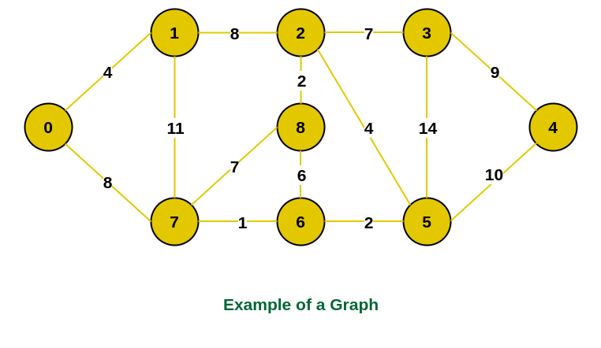
Prim’s Algorithm Example 1

Slide 14
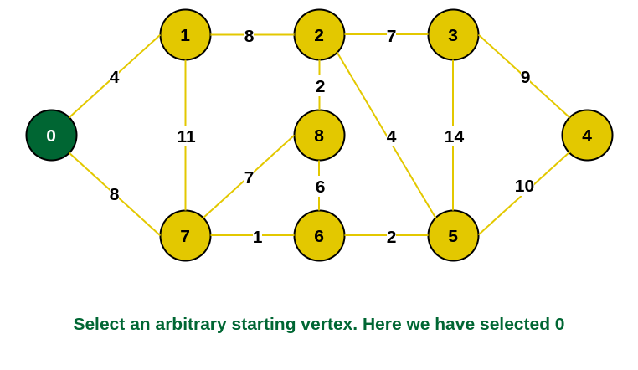
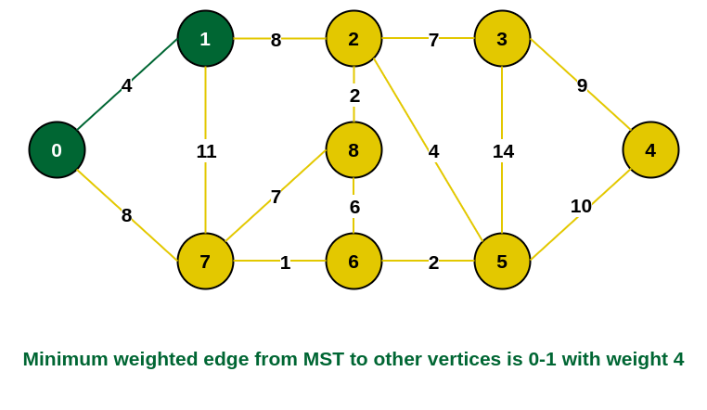
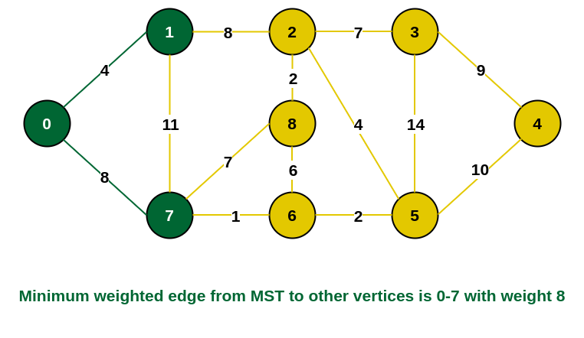
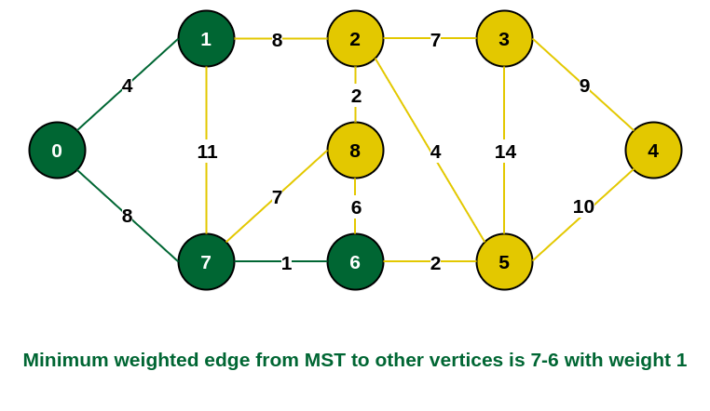
Steps 1-4
Red dotted line denotes the cut between current MST and remaining vertices

Slide 15
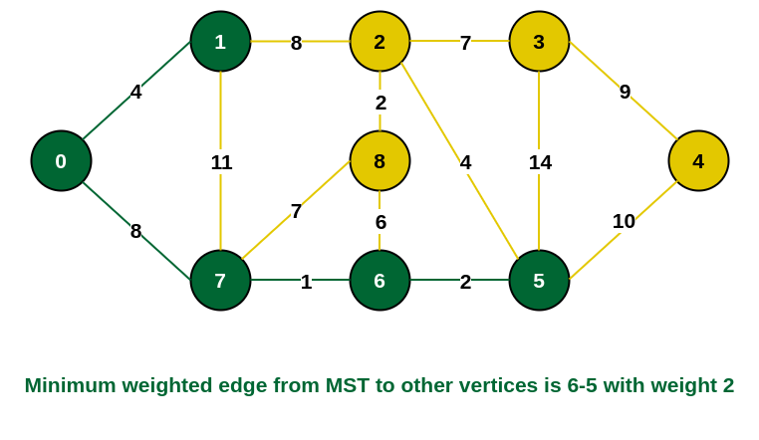
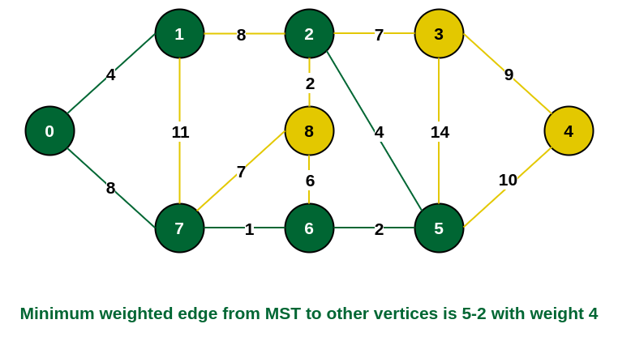
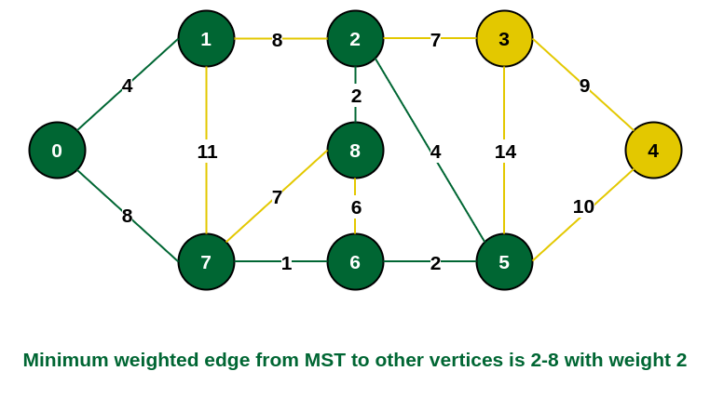
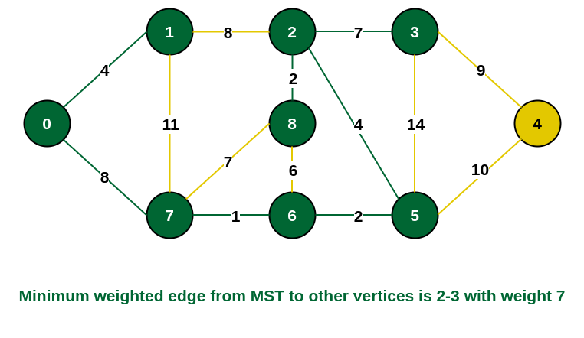
Steps 5-8
Red dotted line denotes the cut between current MST and remaining vertices

Slide 16
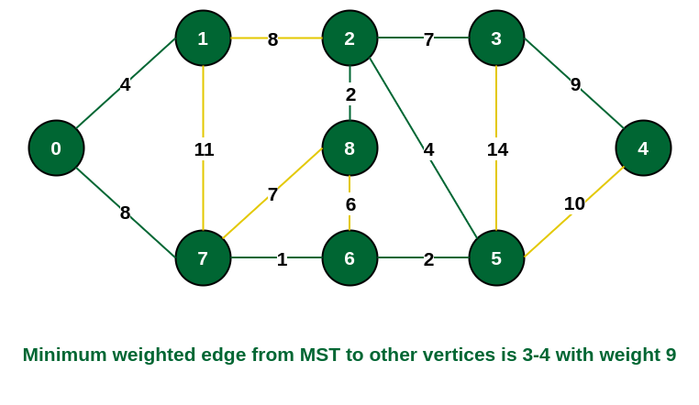
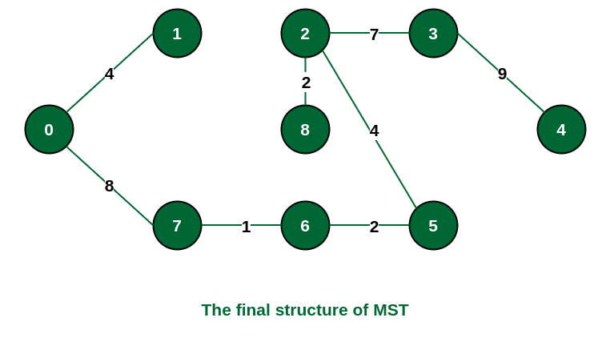
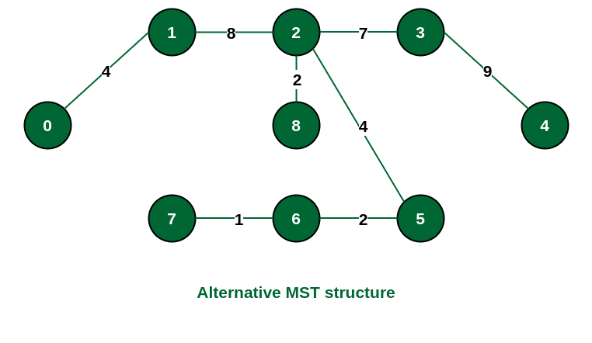
Step 9
If we had selected the edge {1, 2} in the third step then the MST would look like this one

Slide 17
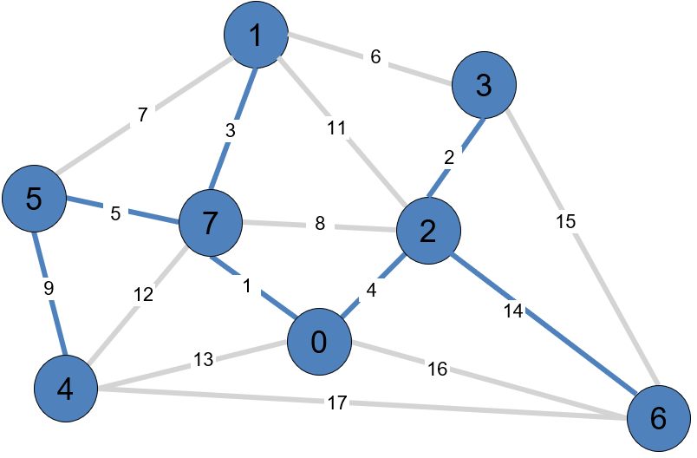
Prim’s Algorithm Example 2
Start with vertex 0 and greedily grow tree T.
Add to T the min weight edge with exactly one endpoint in T.
Repeat until V – 1 edges.
1
6
3
7
3
11
5
2
5
7
2
8
15
9
12
1
4
0
14
4
13
16
17
6
Resulting MST
Prim's algorithm in 2 minutes
https://www.youtube.com/watch?v=cplfcGZmX7I

Slide 18
Proof of Correctness for Prim’s Algorithm
Loop Invariant At each step, the edges selected by Prim's Algorithm form a subset of some MST.
Base Case
Starting from any vertex, the empty set of edges is trivially part of some MST
The initial vertex forms our first component
Inductive Step Let A be our current tree and e be the next edge selected by Prim’s:
e is the minimum weight edge connecting A to V-A (where V is the set of all vertices)
e crosses a cut between visited and unvisited vertices
By the cut property, e must be in some MST
Safety of Edge Selection
For any edge e selected by Prim’s:
It creates a cut (S, V-S) where S is the set of visited vertices
e is the lightest edge crossing this cut
No lighter edge could exist (or it would have been chosen)
Therefore, e is a safe addition to our growing MST
Conclusion
The algorithm is correct because:
It maintains a single growing tree
Each edge selection is optimal (by the cut property)
It terminates with n-1 edges (where n is the number of vertices)
The result is connected (by construction)
Therefore, Prim's Algorithm produces an MST
Notes:
This establishes our starting point

Slide 19
Dijkstra’s Algorithm vs. Prim’s algorithm
Similarities:
Both use a greedy approach.
They employ similar data structures, often using a priority queue.
The basic structures of both algorithms are very similar, with the main difference being in how they update vertex values
Dijkstra's finds shortest paths, while Prim's constructs a minimum spanning tree (MST).
This is reflected in how they calculate and update vertex values:
In Dijkstra's algorithm, choose the closest vertex to the source node (via a directed path), the distance to a vertex is relaxed to sum of the edge weight plus the distance to the previous vertex if it is smaller.
In Prim's algorithm, choose the closest vertex to the tree (via an undirected edge), i.e., the vertex with the minimum weight of the edge connecting it to the MST.
Notes:
Dijkstra’s algorithm seem familiar?
Prim’s algorithm is essentially the same algorithm.
Both are in a family of algorithms that compute a graph’s spanning tree.
Main distinction: Rule used to choose next vertex for the tree.
Prim’s: Closest vertex to the tree (via an undirected edge).
Dijkstra’s: Closest vertex to the source (via a directed path).

Slide 20
Kruskal’s Algorithm
Sort all edges of the given graph in increasing order. Then it keeps on adding new edges and nodes in the MST if the newly added edge does not form a cycle. It picks the minimum weighted edge at first and the maximum weighted edge at last. Thus we can say that it makes a locally optimal choice in each step in order to find the optimal solution. Hence this is a Greedy Algorithm.
1. Sort all the edges in non-decreasing order of their weight.
2. Pick the lowest-cost edge. Check if it forms a cycle with the spanning tree formed so far. If the cycle is not formed, include this edge. Else, discard it.
3. Repeat Step 2 until there are (V-1) edges in the spanning tree.

Slide 21
Time Complexity of Kruskal’s Algorithm
The time complexity of Kruskal's algorithm is determined by two main operations:
Sorting the edges: Sorting all E edges by weight takes O(E log E) using a comparison-based sorting algorithm.
Union-Find operations: For each edge, the algorithm performs union and find operations to check for cycles, with time complexity O(α(V)), where α is the inverse Ackermann function, which grows slower than logarithmic function O(log V).
Thus, the overall time complexity is dominated by the sorting step, resulting in time complexity of O(E log E) or equivalently O(E log V), since E ≤ V² for a connected graph.

Slide 22
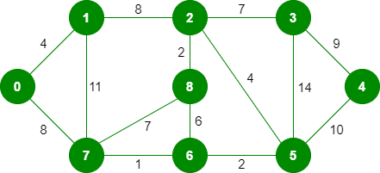
Kruskal’s Algorithm Example 1

Slide 23
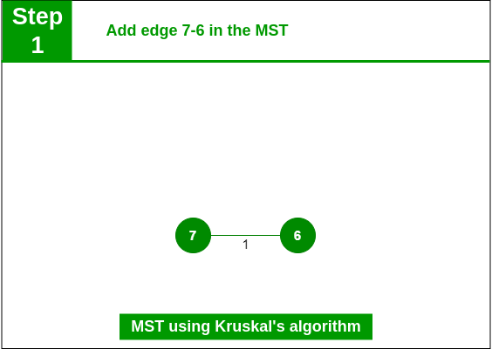
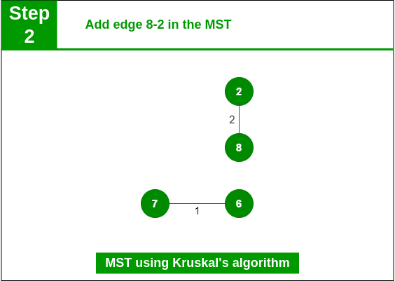
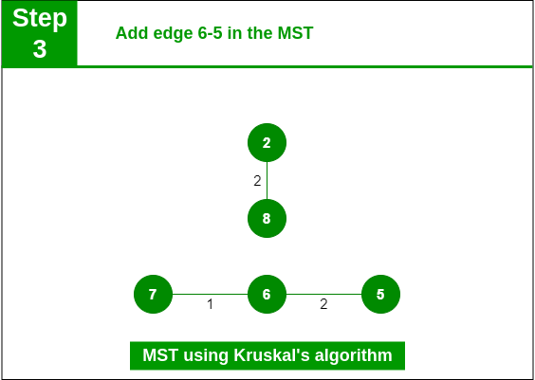
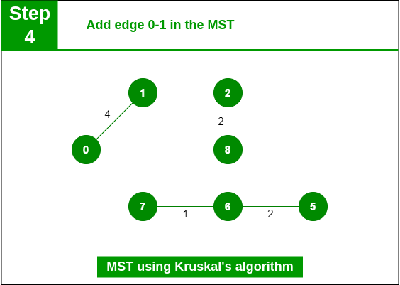
e | W
7-6 | 1
8-2 | 2
6-5 | 2
0-1 | 4
2-5 | 4
8-6 | 6
2-3 | 7
7-8 | 7
0-7 | 8
1-2 | 8
3-4 | 9
5-4 | 10
1-7 | 11
14 | 14

Slide 24
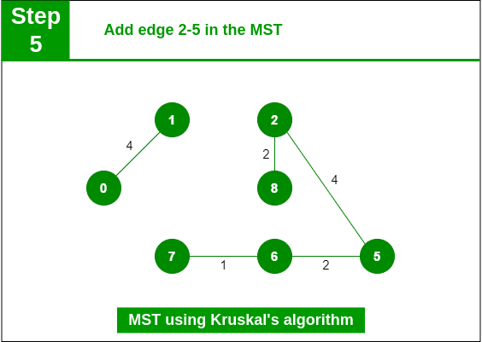
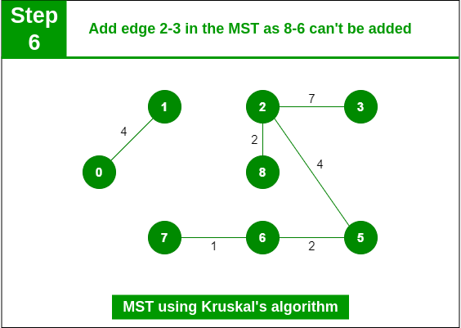
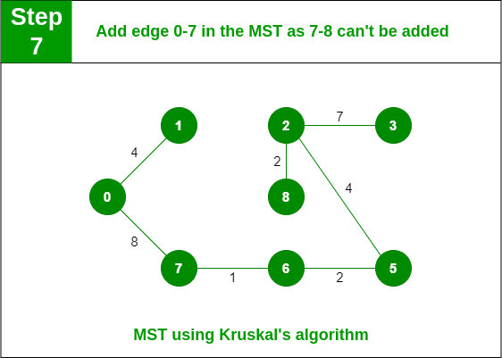
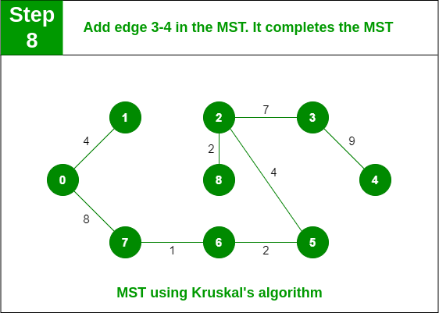
e | W
7-6 | 1
8-2 | 2
6-5 | 2
0-1 | 4
2-5 | 4
8-6 | 6
2-3 | 7
7-8 | 7
0-7 | 8
1-2 | 8
3-4 | 9
5-4 | 10
1-7 | 11
14 | 14

Slide 25
Steps 1-4

Slide 26
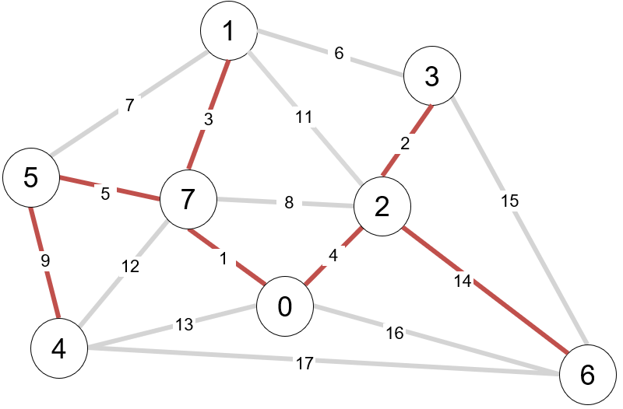
Kruskal’s Algorithm Example 2
Resulting MST
(same result as Prim’s)
Consider edges in ascending order of weight.
Add next edge to tree T unless doing so would create a cycle.
graph edges sorted by weight
does not create a cycle
creates a cycle
0 - 7 | 1
2 - 3 | 2
1 - 7 | 3
0 - 2 | 4
5 - 7 | 5
1 - 3 | 6
1 - 5 | 7
2 - 7 | 8
4 - 5 | 9
1 - 2 | 11
4 - 7 | 12
0 - 4 | 13
2 - 6 | 14
3 - 6 | 15
0 - 6 | 16
4 - 6 | 17
1
5
6
3
7
3
11
5
2
5
7
2
8
15
9
12
1
4
0
14
4
13
16
17
6
Kruskal's algorithm in 2 minutes
https://www.youtube.com/watch?v=71UQH7Pr9kU

Slide 27
Proof of Correctness for Kruskal’s Algorithm
Loop Invariant At each step, the set of edges chosen by Kruskal's Algorithm is a subset of some MST.
Base Case
Initially, the empty set of edges is trivially a subset of any MST
Inductive Step
Let e be the next edge selected by Kruskal's Algorithm. Two key facts:
e is the minimum weight edge that doesn't create a cycle with previously selected edges
The edges selected so far form a forest F
Safety of Edge Selection
Consider the components C1 and C2 that edge e connects:
e is the minimum weight edge between these components
Any path between C1 and C2 in the MST must use at least one edge
That edge cannot be lighter than e (or Kruskal would have chosen it)
Therefore, we can safely include e in our solution
Conclusion
The algorithm terminates when:
It has selected exactly n-1 edges (where n is the number of vertices)
The result is connected (due to the selection process)
Each edge is chosen optimally (by the cut property)
Therefore, Kruskal's Algorithm produces an MST
Notes:
This establishes our starting point

Slide 28
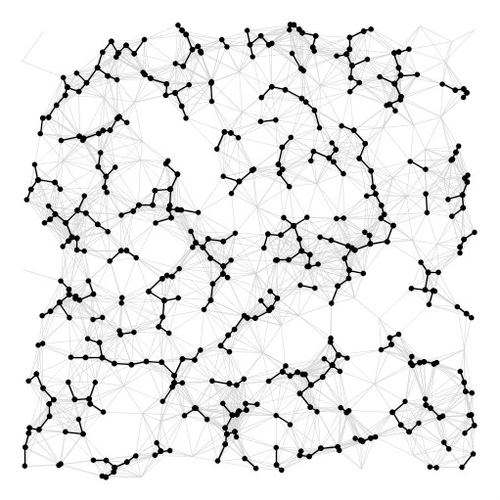
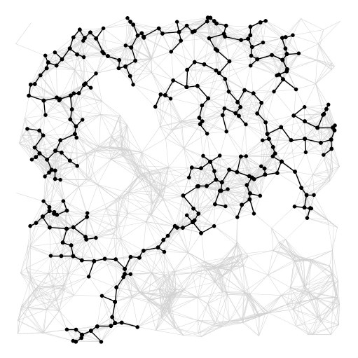
Summary
algorithm
visualization
bottleneck
running time
sorting union–find
Kruskal
E log V
Prim
priority queue
E log V
https://www.youtube.com/watch?v=vmWSnkBVvQ0

Slide 29
References
Prim’s Algorithm for Minimum Spanning Tree (MST) | GeeksforGeeks
https://www.geeksforgeeks.org/prims-minimum-spanning-tree-mst-greedy-algo-5/
https://www.youtube.com/watch?v=eB61LXLZVqs
Kruskal’s Algorithm for Minimum Spanning Tree | GeeksforGeeks
https://www.geeksforgeeks.org/kruskals-minimum-spanning-tree-algorithm-greedy-algo-2/
https://www.youtube.com/watch?v=3rrNH_AizMA
Prim's algorithm in 2 minutes
https://www.youtube.com/watch?v=cplfcGZmX7I
Kruskal’s Algorithm in 2 minutes
https://www.youtube.com/watch?v=71UQH7Pr9kU&t=1s
vid10 kruskals vs prims
https://www.youtube.com/watch?v=vmWSnkBVvQ0
Notes:
https://www.geeksforgeeks.org/kruskals-minimum-spanning-tree-algorithm-greedy-algo-2/

Slide 30
Full-Length Lectures
[CSE 373WI24] Lecture 16: Minimum Spanning Trees
https://www.youtube.com/watch?v=9dGPQqE0dUw&list=PLEcoVsAaONjd5n69K84sSmAuvTrTQT_Nl&index=15

